Slide 1
Who Am I?
I started studying at the Faculty of Health Sciences at Çukurova University - Nurse 👩🏻‍⚕️
I resigned from nursing. 👩🏻‍💻
1997
2021
2023
2015
2023
Born in Adıyaman 🏡
I started studying at Ankara University Computer Programming.
First experience in coding.💻
Up School AD-4
Android Development Programing.👩‍👧‍👧

Slide 2

Structures Used
MVVM Architecture
Hilt
Coroutines
Navigation Component
Retrofit
Room
Firebase Auth
Glide
Chucker

Slide 3
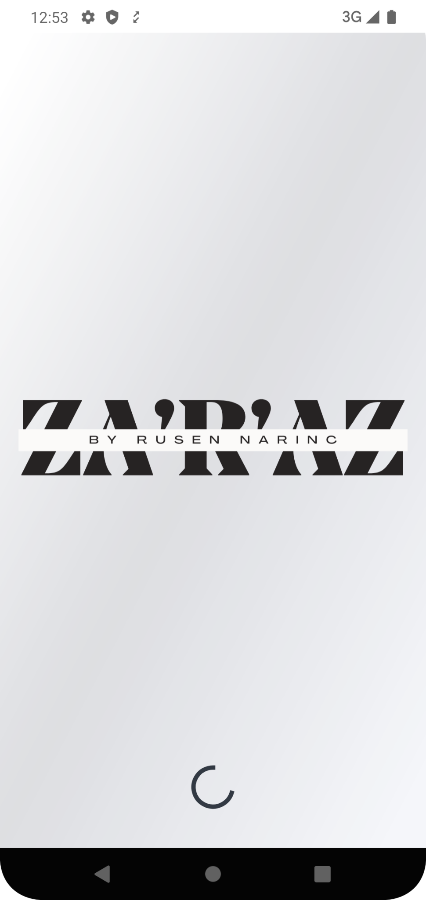
Splash Screen
The splash screen with the application logo is visible for 3 seconds.
After the splash screen if the user has not logged in they are redirected to the login screen; otherwise, they are directed to the main page.

Slide 4
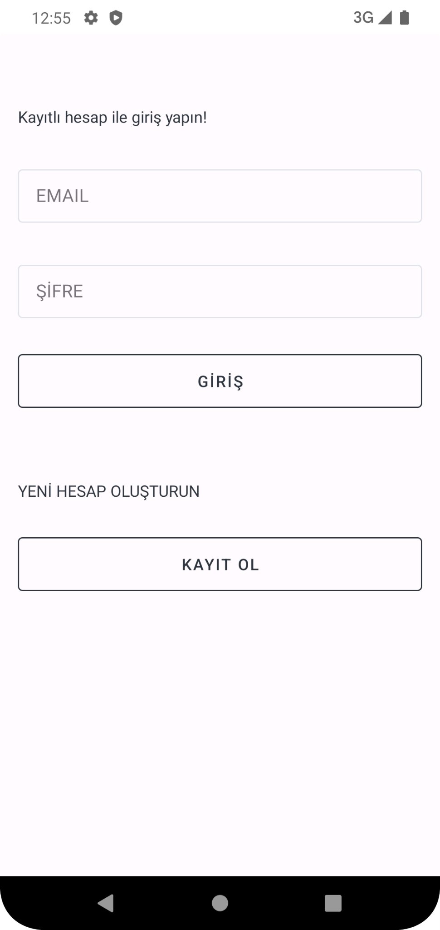
Login Screen
If the user has an account, their email and password information are requested.
If the user does not have an existing account, they are directed to the Register screen with the option to sign up using the Register button.

Slide 5
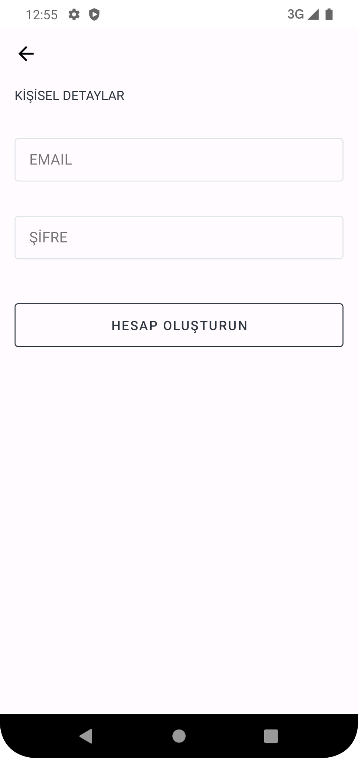
Register Screen
The user signs up with their email and password.
An account is created by clicking the create account button and the user is redirected to the homepage.
The back button returns to the login screen.

Slide 6
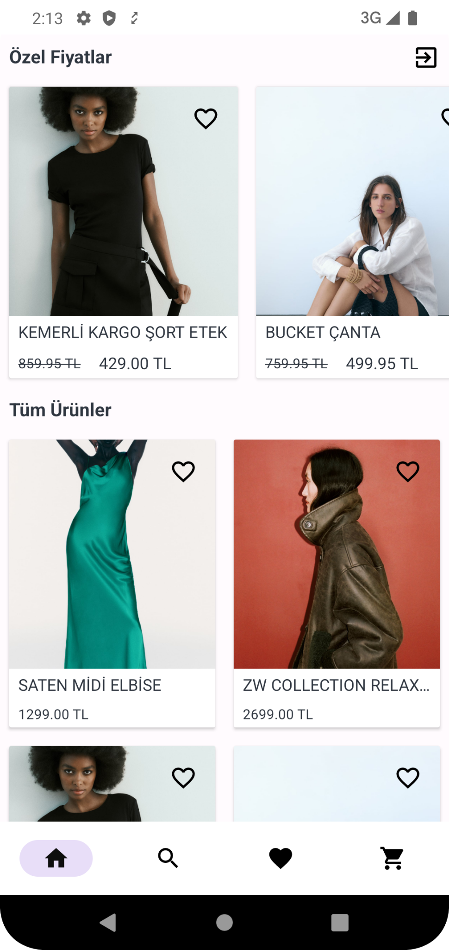
Home Screen
This page contains two different RecyclerViews.
You can log out using the logout button in the top right corner.
Nested Scroll View is used for the scrollability of page.
When you click on the product, you will be redirected to the detail page.
Favoriting is available.

Slide 7
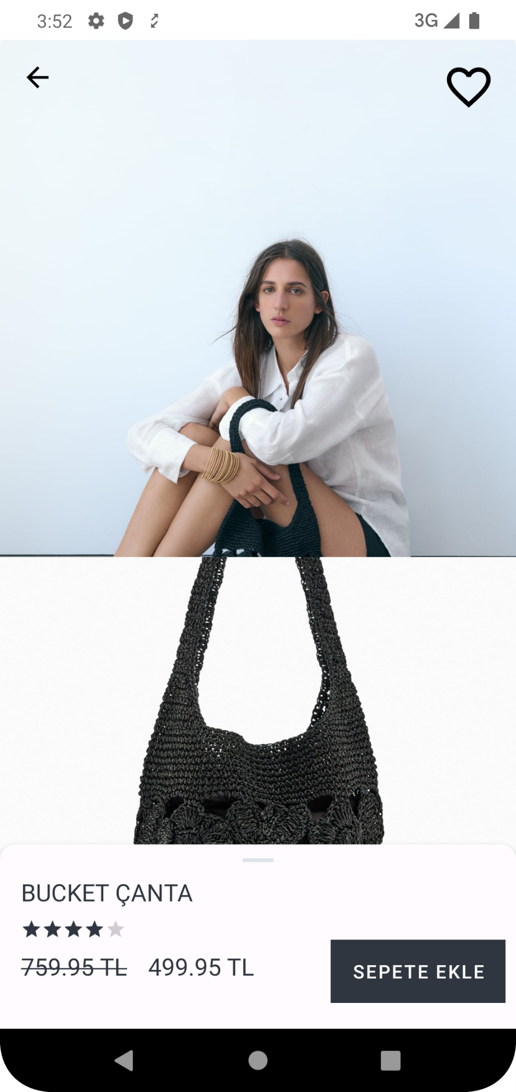
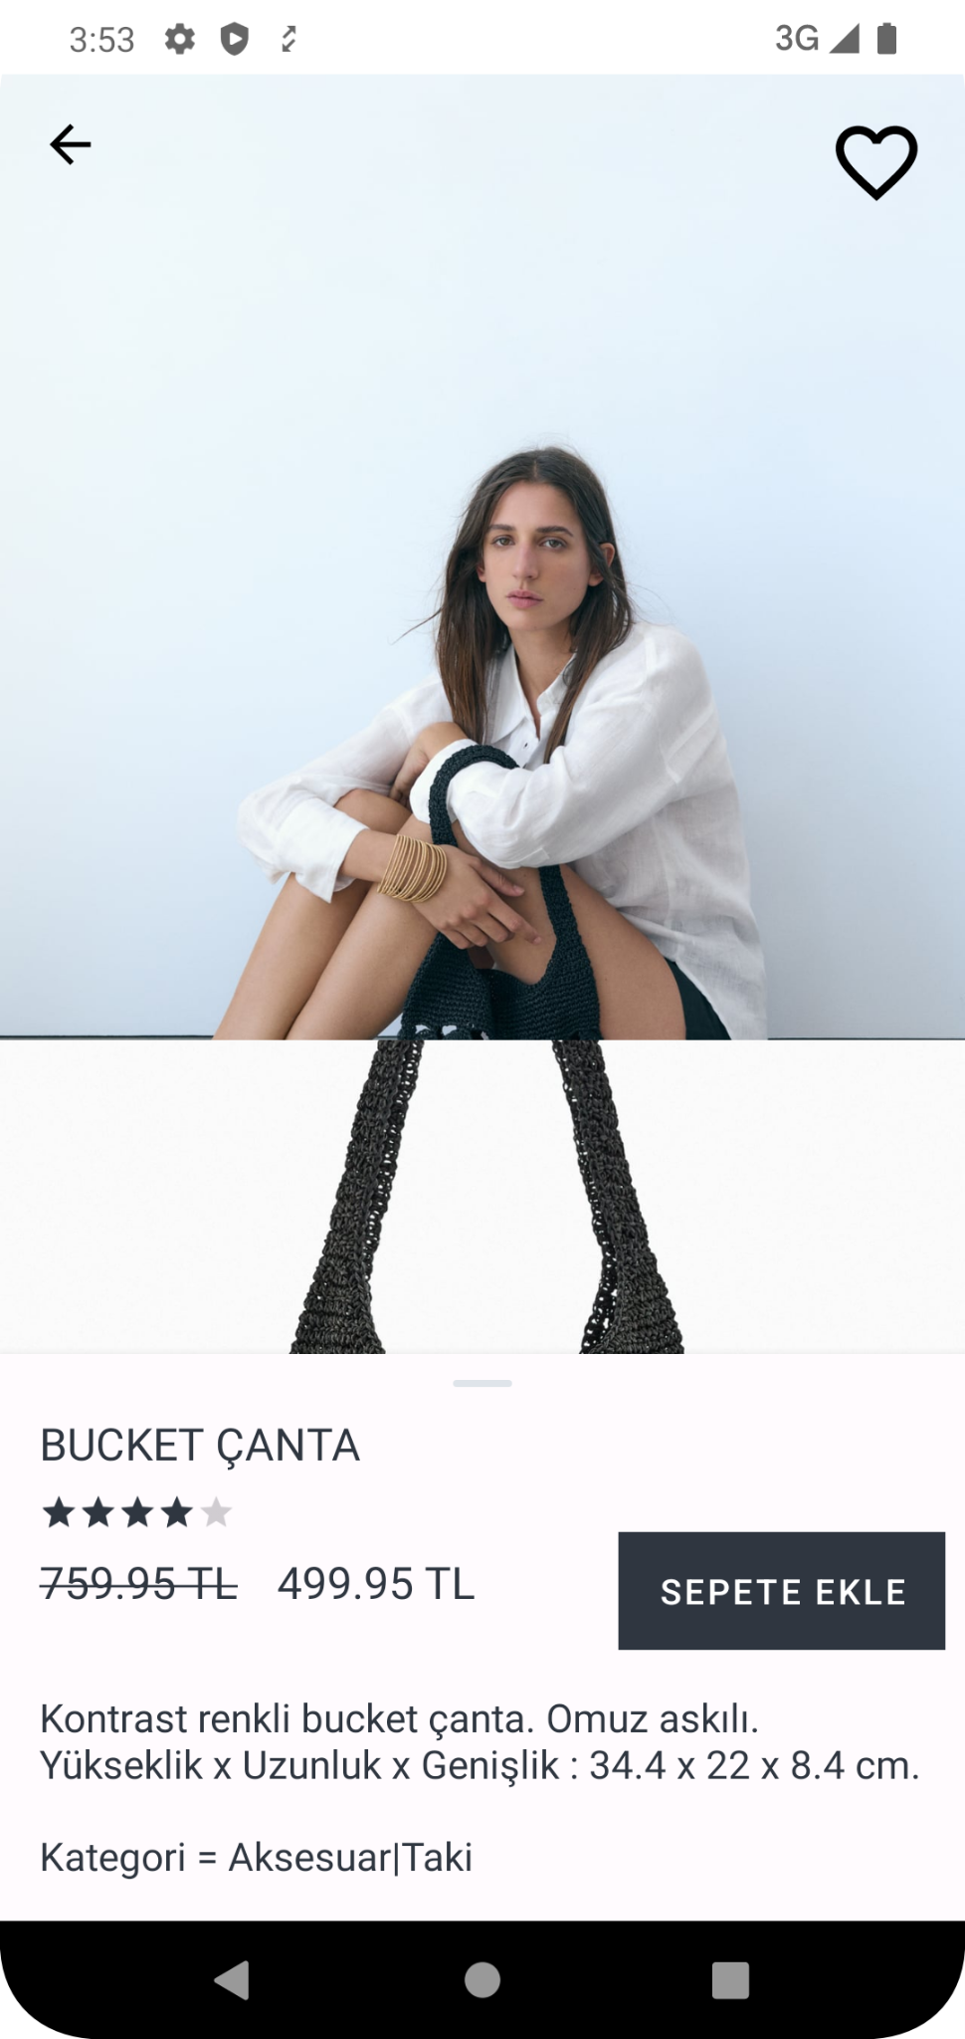
Detail Screen
A vertical RecyclerView is used for photos.
A BottomSheet is utilized for the product description section.
Favoriting action has been implemented.
The product can be added to the cart.

Slide 8
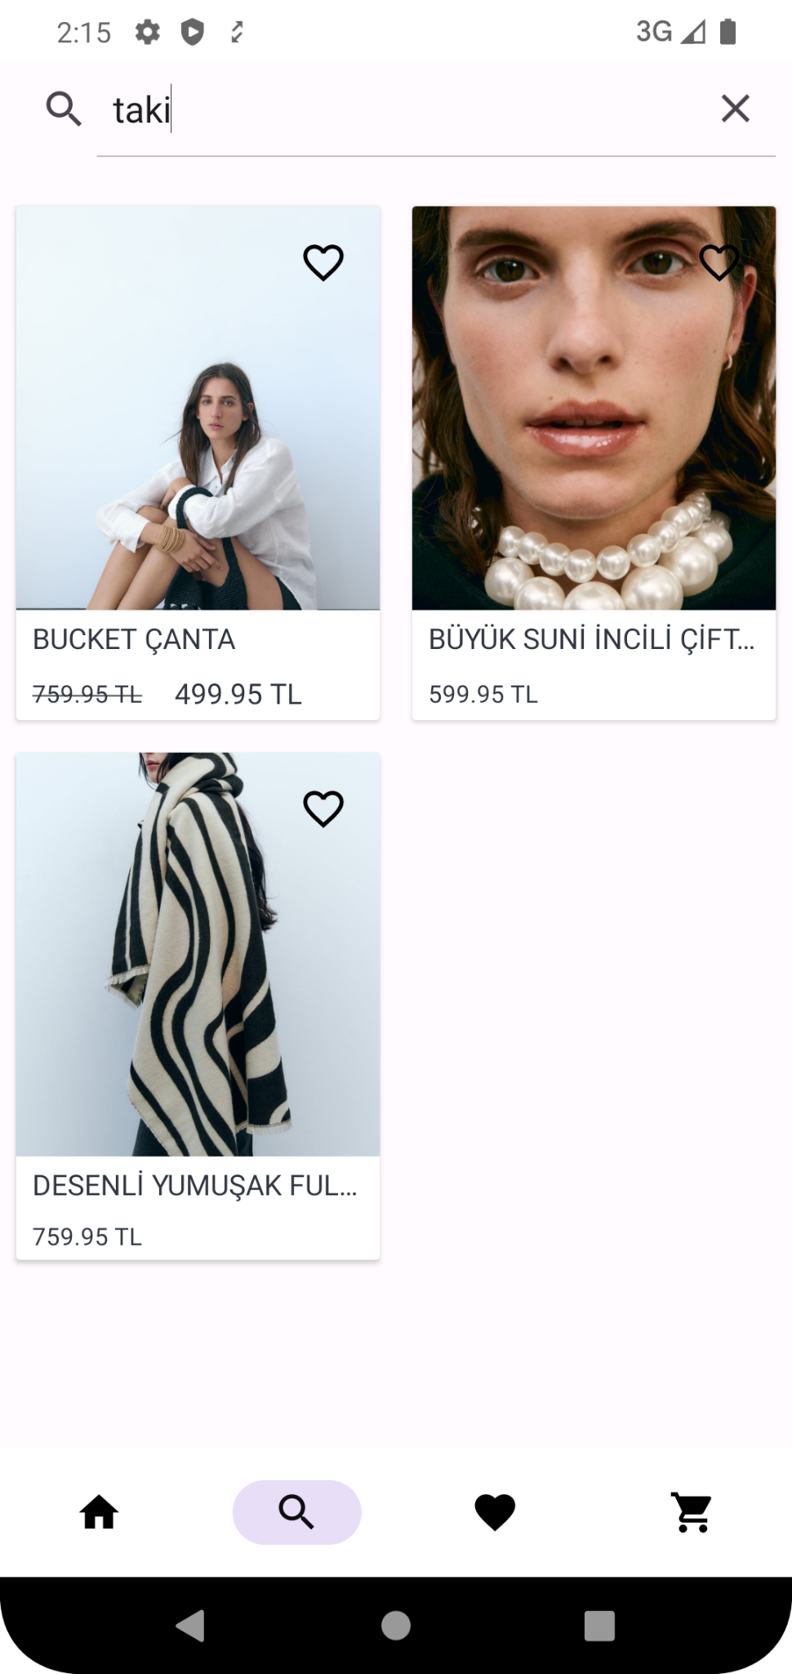
Search Screen
A case- sensitive search with a minimum of 3 characters has been implemented.
You can navigate to the details of the products that appear in the search results.
Favoriting action has been implemented.

Slide 9
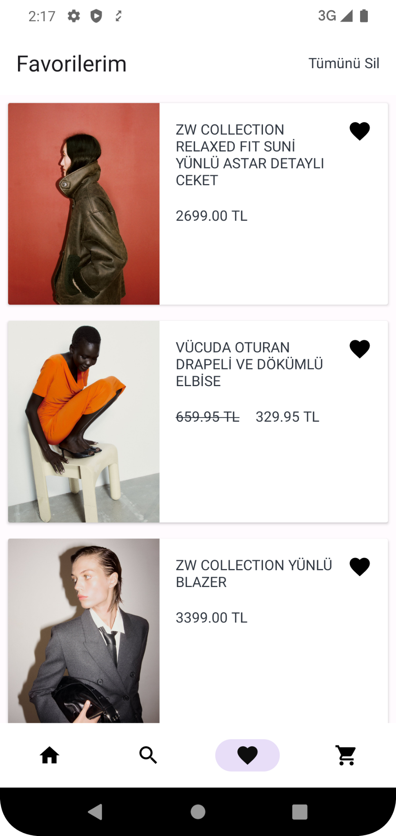
Favorites Screen
The removal from favorites can be done using the ican in the top right corner of the products.
All products are removed from favorites with the delete all actions.
RecyclerView was used.

Slide 10
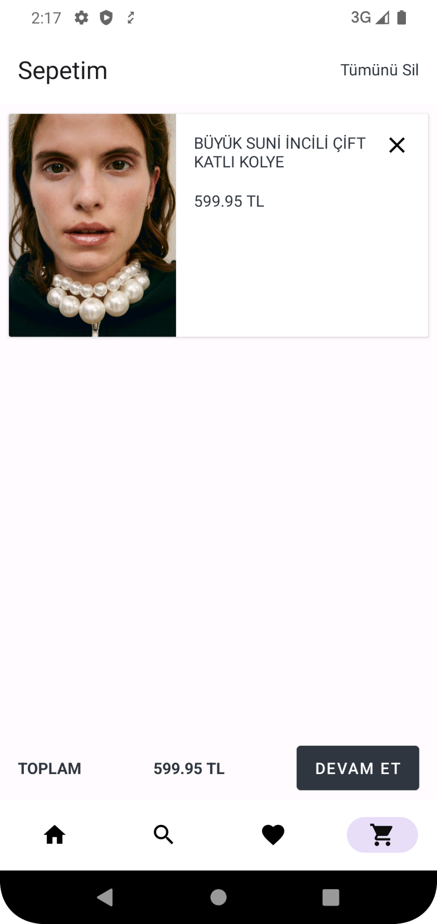
Cart Screen
When clicked on the products, it directs to the detail page.
The total price is displayed.
Redirected to the payment page with the continue button.

Slide 11
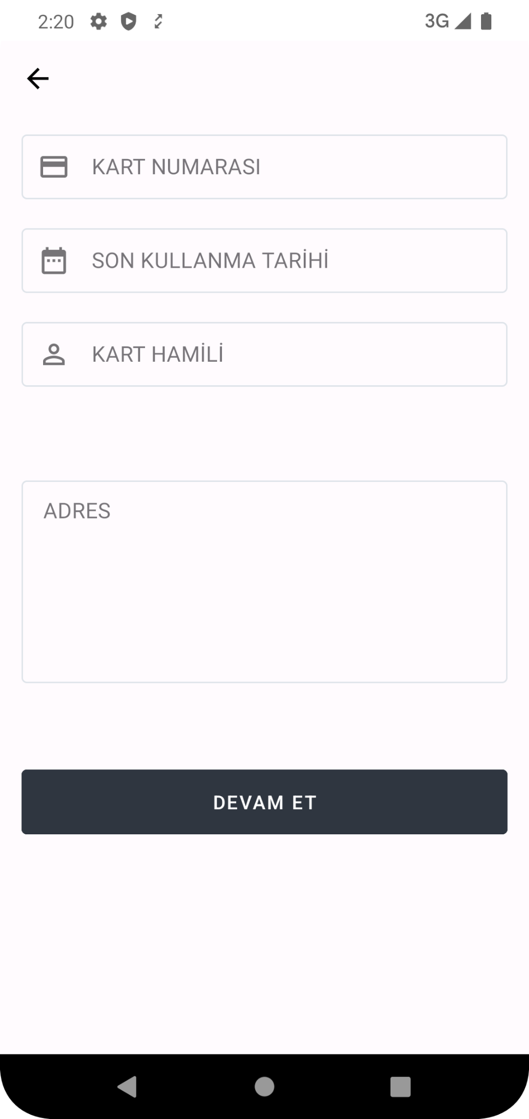
Payment Screen
Credit card information is requested from the user.
Redirected to the result screen with continue button.

Slide 12
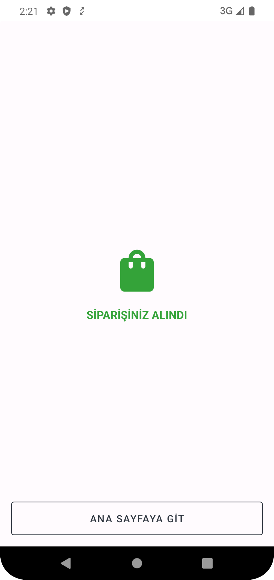
Success Screen
The product purchase process is completed.
Redirected to the main page with the Go to Home button.

Slide 13
